Slide 1
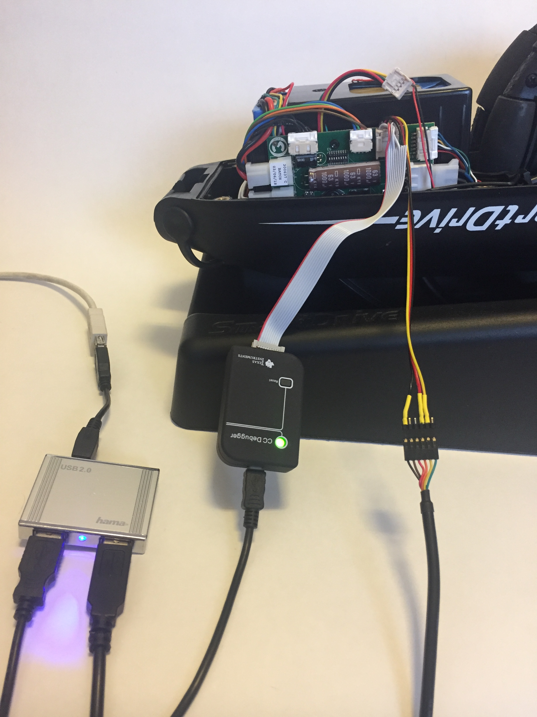
Plug programming cable into battery port MX2+ PCB
CC-Debugger: Ensure light is green if SD is powered ON. Pressing RESET button will attempt to find SD again
Ensure both USB cables are connected to your computer
USB-Serial cable: Ensure Black, Orange and Yellow cables are connected to programming cable

Slide 2
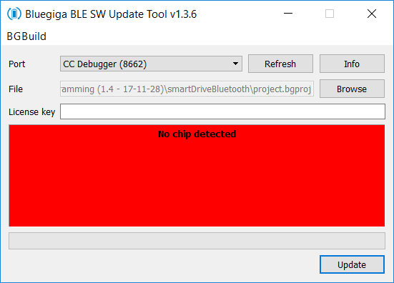
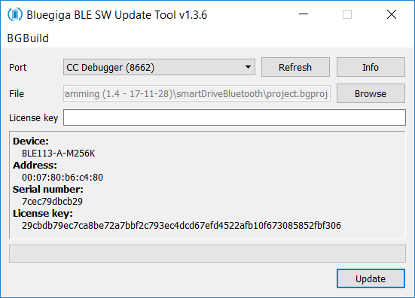
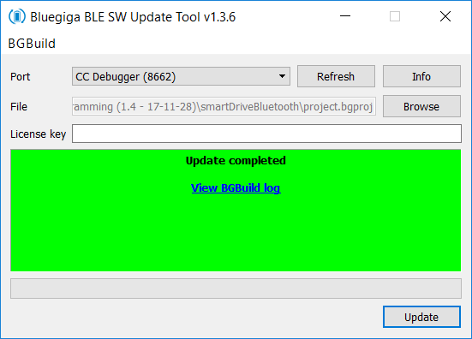
If CC-Debugger light is Red you will see this when you press Info – make sure SmartDrive is ON and cables are all plugged in properly
If SmartDrive is powered ON and CC-Debugger light is Green you should see this when you press Info
After you press Update it will show this – meaning SmartDrive BLE programming is done

